Slide 1

Harry
http://projects.spring.io/spring-cloud/
PPT模板下载：www.1ppt.com/moban/ 行业PPT模板：www.1ppt.com/hangye/
节日PPT模板：www.1ppt.com/jieri/ PPT素材下载：www.1ppt.com/sucai/
PPT背景图片：www.1ppt.com/beijing/ PPT图表下载：www.1ppt.com/tubiao/
优秀PPT下载：www.1ppt.com/xiazai/ PPT教程： www.1ppt.com/powerpoint/
Word教程： www.1ppt.com/word/ Excel教程：www.1ppt.com/excel/
资料下载：www.1ppt.com/ziliao/ PPT课件下载：www.1ppt.com/kejian/
范文下载：www.1ppt.com/fanwen/ 试卷下载：www.1ppt.com/shiti/
教案下载：www.1ppt.com/jiaoan/ PPT论坛：www.1ppt.cn

Slide 2


Microservice 未来 -- Service Mesh
（1）Spring Cloud config [Spring]
（2）Spring Cloud Bus [Spring]
（3）Spring Cloud Eureka [Netflix]
（4）Spring Cloud Hystrix [Netflix]
（5）Spring Cloud Zuul [Netflix]
（6）Spring Cloud Archaius [Netflix]
（7）Spring Cloud Consul [HashiCorp]
（8）Spring Cloud for Cloud Foundry [Pivotal]
（9）Spring Cloud Sleuth [Spring]
（10）Spring Cloud Data Flow [Pivotal]
（11）Spring Cloud Security [Spring]
（12）Spring Cloud Zookeeper [Spring]
（13）Spring Cloud Stream [Spring]
（14）Spring Cloud CLI [Spring]
（15）Spring Cloud Ribbon [Netflix]
（16）Spring Cloud Turbine [Netflix]
（17）Spring Cloud Feign [OpenFeign]
（18）Spring Cloud Task [Spring]
（19）Spring Cloud Connectors [Spring]
（20）Spring Cloud Cluster [Spring]
（21）Spring Cloud Starters [Pivotal]
PPT模板下载：www.1ppt.com/moban/ 行业PPT模板：www.1ppt.com/hangye/
节日PPT模板：www.1ppt.com/jieri/ PPT素材下载：www.1ppt.com/sucai/
PPT背景图片：www.1ppt.com/beijing/ PPT图表下载：www.1ppt.com/tubiao/
优秀PPT下载：www.1ppt.com/xiazai/ PPT教程： www.1ppt.com/powerpoint/
Word教程： www.1ppt.com/word/ Excel教程：www.1ppt.com/excel/
资料下载：www.1ppt.com/ziliao/ PPT课件下载：www.1ppt.com/kejian/
范文下载：www.1ppt.com/fanwen/ 试卷下载：www.1ppt.com/shiti/
教案下载：www.1ppt.com/jiaoan/ PPT论坛：www.1ppt.cn

Slide 3

Spring Cloud
（1）Spring Cloud config [Spring]
（2）Spring Cloud Bus [Spring]
（3）Spring Cloud Eureka [Netflix]
（4）Spring Cloud Hystrix [Netflix]
（5）Spring Cloud Zuul [Netflix]
（6）Spring Cloud Archaius [Netflix]
（7）Spring Cloud Consul [HashiCorp]
（8）Spring Cloud for Cloud Foundry [Pivotal]
（9）Spring Cloud Sleuth [Spring]
（10）Spring Cloud Data Flow [Pivotal]
（11）Spring Cloud Security [Spring]
（12）Spring Cloud Zookeeper [Spring]
（13）Spring Cloud Stream [Spring]
（14）Spring Cloud CLI [Spring]
（15）Spring Cloud Ribbon [Netflix]
（16）Spring Cloud Turbine [Netflix]
（17）Spring Cloud Feign [OpenFeign]
（18）Spring Cloud Task [Spring]
（19）Spring Cloud Connectors [Spring]
（20）Spring Cloud Cluster [Spring]
（21）Spring Cloud Starters [Pivotal]
PPT模板下载：www.1ppt.com/moban/ 行业PPT模板：www.1ppt.com/hangye/
节日PPT模板：www.1ppt.com/jieri/ PPT素材下载：www.1ppt.com/sucai/
PPT背景图片：www.1ppt.com/beijing/ PPT图表下载：www.1ppt.com/tubiao/
优秀PPT下载：www.1ppt.com/xiazai/ PPT教程： www.1ppt.com/powerpoint/
Word教程： www.1ppt.com/word/ Excel教程：www.1ppt.com/excel/
资料下载：www.1ppt.com/ziliao/ PPT课件下载：www.1ppt.com/kejian/
范文下载：www.1ppt.com/fanwen/ 试卷下载：www.1ppt.com/shiti/
教案下载：www.1ppt.com/jiaoan/ PPT论坛：www.1ppt.cn

Slide 4









Spring Cloud Common Core Components
PPT模板下载：www.1ppt.com/moban/ 行业PPT模板：www.1ppt.com/hangye/
节日PPT模板：www.1ppt.com/jieri/ PPT素材下载：www.1ppt.com/sucai/
PPT背景图片：www.1ppt.com/beijing/ PPT图表下载：www.1ppt.com/tubiao/
优秀PPT下载：www.1ppt.com/xiazai/ PPT教程： www.1ppt.com/powerpoint/
Word教程： www.1ppt.com/word/ Excel教程：www.1ppt.com/excel/
资料下载：www.1ppt.com/ziliao/ PPT课件下载：www.1ppt.com/kejian/
范文下载：www.1ppt.com/fanwen/ 试卷下载：www.1ppt.com/shiti/
教案下载：www.1ppt.com/jiaoan/ PPT论坛：www.1ppt.cn

Slide 5
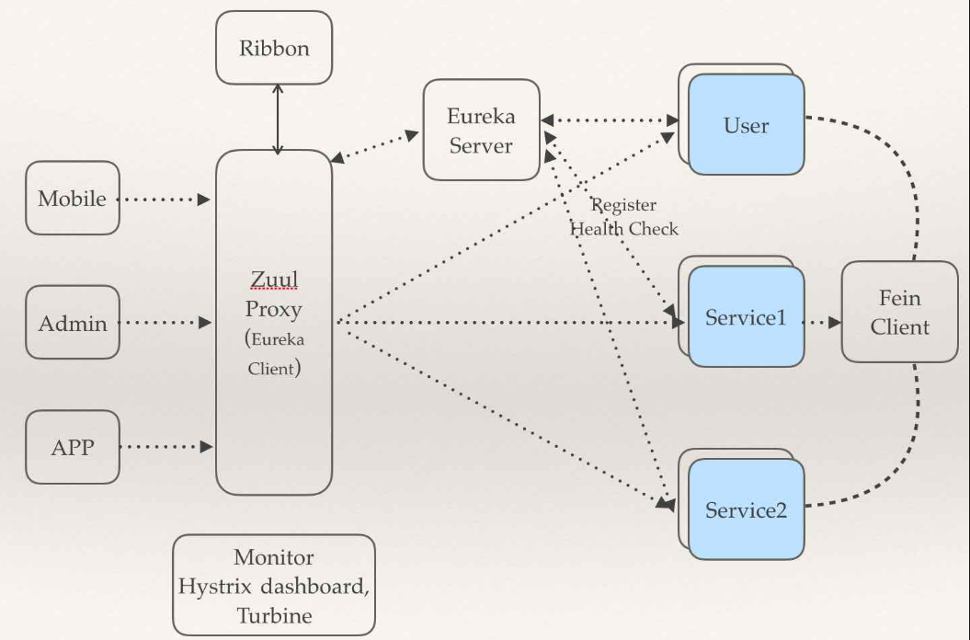
Spring Cloud Components Relations
PPT模板下载：www.1ppt.com/moban/ 行业PPT模板：www.1ppt.com/hangye/
节日PPT模板：www.1ppt.com/jieri/ PPT素材下载：www.1ppt.com/sucai/
PPT背景图片：www.1ppt.com/beijing/ PPT图表下载：www.1ppt.com/tubiao/
优秀PPT下载：www.1ppt.com/xiazai/ PPT教程： www.1ppt.com/powerpoint/
Word教程： www.1ppt.com/word/ Excel教程：www.1ppt.com/excel/
资料下载：www.1ppt.com/ziliao/ PPT课件下载：www.1ppt.com/kejian/
范文下载：www.1ppt.com/fanwen/ 试卷下载：www.1ppt.com/shiti/
教案下载：www.1ppt.com/jiaoan/ PPT论坛：www.1ppt.cn

Slide 6
Spring Cloud Eureka
https://github.com/Netflix/eureka
云端服务发现，一个基于 REST 的服务，用于定位服务，以实现云端中间层服务发现和故障转移。
PPT模板下载：www.1ppt.com/moban/ 行业PPT模板：www.1ppt.com/hangye/
节日PPT模板：www.1ppt.com/jieri/ PPT素材下载：www.1ppt.com/sucai/
PPT背景图片：www.1ppt.com/beijing/ PPT图表下载：www.1ppt.com/tubiao/
优秀PPT下载：www.1ppt.com/xiazai/ PPT教程： www.1ppt.com/powerpoint/
Word教程： www.1ppt.com/word/ Excel教程：www.1ppt.com/excel/
资料下载：www.1ppt.com/ziliao/ PPT课件下载：www.1ppt.com/kejian/
范文下载：www.1ppt.com/fanwen/ 试卷下载：www.1ppt.com/shiti/
教案下载：www.1ppt.com/jiaoan/ PPT论坛：www.1ppt.cn

Slide 7
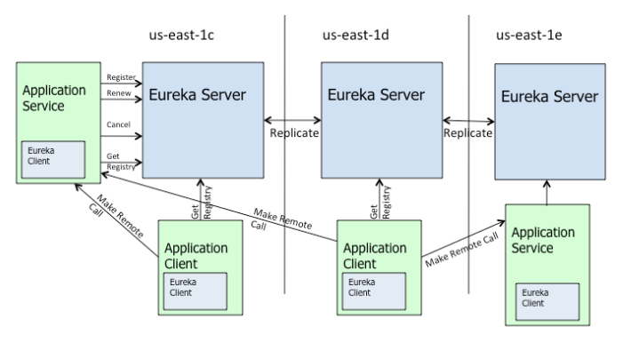
Spring Cloud Eureka
PPT模板下载：www.1ppt.com/moban/ 行业PPT模板：www.1ppt.com/hangye/
节日PPT模板：www.1ppt.com/jieri/ PPT素材下载：www.1ppt.com/sucai/
PPT背景图片：www.1ppt.com/beijing/ PPT图表下载：www.1ppt.com/tubiao/
优秀PPT下载：www.1ppt.com/xiazai/ PPT教程： www.1ppt.com/powerpoint/
Word教程： www.1ppt.com/word/ Excel教程：www.1ppt.com/excel/
资料下载：www.1ppt.com/ziliao/ PPT课件下载：www.1ppt.com/kejian/
范文下载：www.1ppt.com/fanwen/ 试卷下载：www.1ppt.com/shiti/
教案下载：www.1ppt.com/jiaoan/ PPT论坛：www.1ppt.cn

Slide 8
Spring Cloud Eureka VS Alibaba Nacos
Nacos 是阿里巴巴的新开源项目，其核心定位是 “一个更易于帮助构建云原生应用的动态服务发现、配置和服务管理平台”。
PPT模板下载：www.1ppt.com/moban/ 行业PPT模板：www.1ppt.com/hangye/
节日PPT模板：www.1ppt.com/jieri/ PPT素材下载：www.1ppt.com/sucai/
PPT背景图片：www.1ppt.com/beijing/ PPT图表下载：www.1ppt.com/tubiao/
优秀PPT下载：www.1ppt.com/xiazai/ PPT教程： www.1ppt.com/powerpoint/
Word教程： www.1ppt.com/word/ Excel教程：www.1ppt.com/excel/
资料下载：www.1ppt.com/ziliao/ PPT课件下载：www.1ppt.com/kejian/
范文下载：www.1ppt.com/fanwen/ 试卷下载：www.1ppt.com/shiti/
教案下载：www.1ppt.com/jiaoan/ PPT论坛：www.1ppt.cn

Slide 9
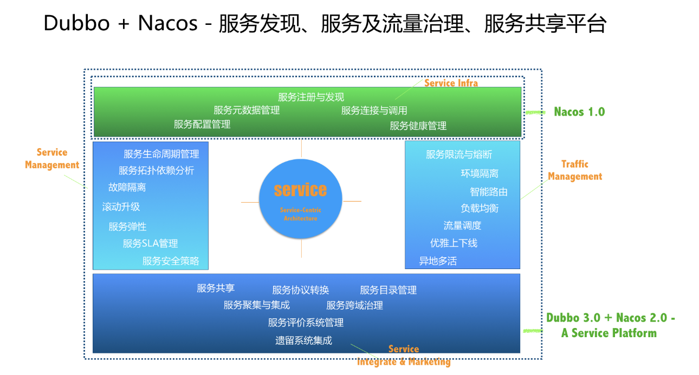
Alibaba Nacos
Service Discovery and Service Health Check
Dynamic Configuration Management
Dynamic DNS Service
Service and MetaData Management
PPT模板下载：www.1ppt.com/moban/ 行业PPT模板：www.1ppt.com/hangye/
节日PPT模板：www.1ppt.com/jieri/ PPT素材下载：www.1ppt.com/sucai/
PPT背景图片：www.1ppt.com/beijing/ PPT图表下载：www.1ppt.com/tubiao/
优秀PPT下载：www.1ppt.com/xiazai/ PPT教程： www.1ppt.com/powerpoint/
Word教程： www.1ppt.com/word/ Excel教程：www.1ppt.com/excel/
资料下载：www.1ppt.com/ziliao/ PPT课件下载：www.1ppt.com/kejian/
范文下载：www.1ppt.com/fanwen/ 试卷下载：www.1ppt.com/shiti/
教案下载：www.1ppt.com/jiaoan/ PPT论坛：www.1ppt.cn

Slide 10
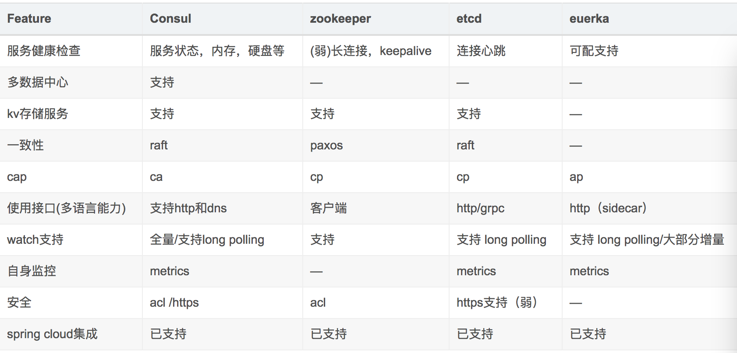
Eureka vs Consul vs Zookeeper vs Etcd
PPT模板下载：www.1ppt.com/moban/ 行业PPT模板：www.1ppt.com/hangye/
节日PPT模板：www.1ppt.com/jieri/ PPT素材下载：www.1ppt.com/sucai/
PPT背景图片：www.1ppt.com/beijing/ PPT图表下载：www.1ppt.com/tubiao/
优秀PPT下载：www.1ppt.com/xiazai/ PPT教程： www.1ppt.com/powerpoint/
Word教程： www.1ppt.com/word/ Excel教程：www.1ppt.com/excel/
资料下载：www.1ppt.com/ziliao/ PPT课件下载：www.1ppt.com/kejian/
范文下载：www.1ppt.com/fanwen/ 试卷下载：www.1ppt.com/shiti/
教案下载：www.1ppt.com/jiaoan/ PPT论坛：www.1ppt.cn

Slide 11
Spring Cloud Ribbon
https://github.com/Netflix/ribbon
提供客户端的负载均衡，有多种负载均衡策略可供选择，可配合服务发现和断路器使用
PPT模板下载：www.1ppt.com/moban/ 行业PPT模板：www.1ppt.com/hangye/
节日PPT模板：www.1ppt.com/jieri/ PPT素材下载：www.1ppt.com/sucai/
PPT背景图片：www.1ppt.com/beijing/ PPT图表下载：www.1ppt.com/tubiao/
优秀PPT下载：www.1ppt.com/xiazai/ PPT教程： www.1ppt.com/powerpoint/
Word教程： www.1ppt.com/word/ Excel教程：www.1ppt.com/excel/
资料下载：www.1ppt.com/ziliao/ PPT课件下载：www.1ppt.com/kejian/
范文下载：www.1ppt.com/fanwen/ 试卷下载：www.1ppt.com/shiti/
教案下载：www.1ppt.com/jiaoan/ PPT论坛：www.1ppt.cn

Slide 12
Spring Cloud Hystrix
https://github.com/Netflix/hystrix
熔断器，容错管理工具，旨在通过熔断机制控制服务和第三方库的节点,从而对延迟和故障提供更强大的容错能力
PPT模板下载：www.1ppt.com/moban/ 行业PPT模板：www.1ppt.com/hangye/
节日PPT模板：www.1ppt.com/jieri/ PPT素材下载：www.1ppt.com/sucai/
PPT背景图片：www.1ppt.com/beijing/ PPT图表下载：www.1ppt.com/tubiao/
优秀PPT下载：www.1ppt.com/xiazai/ PPT教程： www.1ppt.com/powerpoint/
Word教程： www.1ppt.com/word/ Excel教程：www.1ppt.com/excel/
资料下载：www.1ppt.com/ziliao/ PPT课件下载：www.1ppt.com/kejian/
范文下载：www.1ppt.com/fanwen/ 试卷下载：www.1ppt.com/shiti/
教案下载：www.1ppt.com/jiaoan/ PPT论坛：www.1ppt.cn

Slide 13

Spring Cloud Hystrix VS Alibaba Sentinel
https://github.com/alibaba/Sentinel
A lightweight flow-control library providing high-available protection and monitoring
PPT模板下载：www.1ppt.com/moban/ 行业PPT模板：www.1ppt.com/hangye/
节日PPT模板：www.1ppt.com/jieri/ PPT素材下载：www.1ppt.com/sucai/
PPT背景图片：www.1ppt.com/beijing/ PPT图表下载：www.1ppt.com/tubiao/
优秀PPT下载：www.1ppt.com/xiazai/ PPT教程： www.1ppt.com/powerpoint/
Word教程： www.1ppt.com/word/ Excel教程：www.1ppt.com/excel/
资料下载：www.1ppt.com/ziliao/ PPT课件下载：www.1ppt.com/kejian/
范文下载：www.1ppt.com/fanwen/ 试卷下载：www.1ppt.com/shiti/
教案下载：www.1ppt.com/jiaoan/ PPT论坛：www.1ppt.cn

Slide 14
Spring Cloud Feign
https://github.com/OpenFeign/feign
Feign是一种声明式、模板化的HTTP客户端
PPT模板下载：www.1ppt.com/moban/ 行业PPT模板：www.1ppt.com/hangye/
节日PPT模板：www.1ppt.com/jieri/ PPT素材下载：www.1ppt.com/sucai/
PPT背景图片：www.1ppt.com/beijing/ PPT图表下载：www.1ppt.com/tubiao/
优秀PPT下载：www.1ppt.com/xiazai/ PPT教程： www.1ppt.com/powerpoint/
Word教程： www.1ppt.com/word/ Excel教程：www.1ppt.com/excel/
资料下载：www.1ppt.com/ziliao/ PPT课件下载：www.1ppt.com/kejian/
范文下载：www.1ppt.com/fanwen/ 试卷下载：www.1ppt.com/shiti/
教案下载：www.1ppt.com/jiaoan/ PPT论坛：www.1ppt.cn

Slide 15
Spring Cloud Zuul
https://github.com/Netflix/zuul
Zuul 是在云平台上提供动态路由,监控,弹性,安全等边缘服务的框架。Zuul 相当于是设备和 Netflix 流应用的 Web 网站后端所有请求的前门
PPT模板下载：www.1ppt.com/moban/ 行业PPT模板：www.1ppt.com/hangye/
节日PPT模板：www.1ppt.com/jieri/ PPT素材下载：www.1ppt.com/sucai/
PPT背景图片：www.1ppt.com/beijing/ PPT图表下载：www.1ppt.com/tubiao/
优秀PPT下载：www.1ppt.com/xiazai/ PPT教程： www.1ppt.com/powerpoint/
Word教程： www.1ppt.com/word/ Excel教程：www.1ppt.com/excel/
资料下载：www.1ppt.com/ziliao/ PPT课件下载：www.1ppt.com/kejian/
范文下载：www.1ppt.com/fanwen/ 试卷下载：www.1ppt.com/shiti/
教案下载：www.1ppt.com/jiaoan/ PPT论坛：www.1ppt.cn

Slide 16
Spring Cloud Zuul
Request routing
Request filtering
Dynamic routing
Filter
Exception handling
Retry
Authentication
Security
Pressure measurement
Business compose
PPT模板下载：www.1ppt.com/moban/ 行业PPT模板：www.1ppt.com/hangye/
节日PPT模板：www.1ppt.com/jieri/ PPT素材下载：www.1ppt.com/sucai/
PPT背景图片：www.1ppt.com/beijing/ PPT图表下载：www.1ppt.com/tubiao/
优秀PPT下载：www.1ppt.com/xiazai/ PPT教程： www.1ppt.com/powerpoint/
Word教程： www.1ppt.com/word/ Excel教程：www.1ppt.com/excel/
资料下载：www.1ppt.com/ziliao/ PPT课件下载：www.1ppt.com/kejian/
范文下载：www.1ppt.com/fanwen/ 试卷下载：www.1ppt.com/shiti/
教案下载：www.1ppt.com/jiaoan/ PPT论坛：www.1ppt.cn

Slide 17
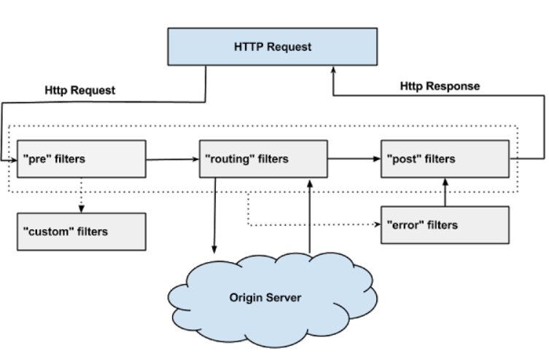
Spring Cloud Zuul-ZuulFilter
PPT模板下载：www.1ppt.com/moban/ 行业PPT模板：www.1ppt.com/hangye/
节日PPT模板：www.1ppt.com/jieri/ PPT素材下载：www.1ppt.com/sucai/
PPT背景图片：www.1ppt.com/beijing/ PPT图表下载：www.1ppt.com/tubiao/
优秀PPT下载：www.1ppt.com/xiazai/ PPT教程： www.1ppt.com/powerpoint/
Word教程： www.1ppt.com/word/ Excel教程：www.1ppt.com/excel/
资料下载：www.1ppt.com/ziliao/ PPT课件下载：www.1ppt.com/kejian/
范文下载：www.1ppt.com/fanwen/ 试卷下载：www.1ppt.com/shiti/
教案下载：www.1ppt.com/jiaoan/ PPT论坛：www.1ppt.cn

Slide 18
Spring Cloud Config
https://github.com/spring-cloud/spring-cloud-config/
配置管理工具包，让你可以把配置放到远程服务器，集中化管理集群配置，目前支持本地存储、Git以及Subversion
PPT模板下载：www.1ppt.com/moban/ 行业PPT模板：www.1ppt.com/hangye/
节日PPT模板：www.1ppt.com/jieri/ PPT素材下载：www.1ppt.com/sucai/
PPT背景图片：www.1ppt.com/beijing/ PPT图表下载：www.1ppt.com/tubiao/
优秀PPT下载：www.1ppt.com/xiazai/ PPT教程： www.1ppt.com/powerpoint/
Word教程： www.1ppt.com/word/ Excel教程：www.1ppt.com/excel/
资料下载：www.1ppt.com/ziliao/ PPT课件下载：www.1ppt.com/kejian/
范文下载：www.1ppt.com/fanwen/ 试卷下载：www.1ppt.com/shiti/
教案下载：www.1ppt.com/jiaoan/ PPT论坛：www.1ppt.cn

Slide 19
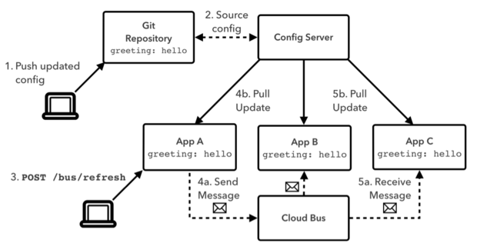
PPT模板下载：www.1ppt.com/moban/ 行业PPT模板：www.1ppt.com/hangye/
节日PPT模板：www.1ppt.com/jieri/ PPT素材下载：www.1ppt.com/sucai/
PPT背景图片：www.1ppt.com/beijing/ PPT图表下载：www.1ppt.com/tubiao/
优秀PPT下载：www.1ppt.com/xiazai/ PPT教程： www.1ppt.com/powerpoint/
Word教程： www.1ppt.com/word/ Excel教程：www.1ppt.com/excel/
资料下载：www.1ppt.com/ziliao/ PPT课件下载：www.1ppt.com/kejian/
范文下载：www.1ppt.com/fanwen/ 试卷下载：www.1ppt.com/shiti/
教案下载：www.1ppt.com/jiaoan/ PPT论坛：www.1ppt.cn

Slide 20

Spring Cloud Bus
https://github.com/spring-cloud/spring-cloud-bus
事件、消息总线，用于在集群（例如，配置变化事件）中传播状态变化，可与Spring Cloud Config联合实现热部署
PPT模板下载：www.1ppt.com/moban/ 行业PPT模板：www.1ppt.com/hangye/
节日PPT模板：www.1ppt.com/jieri/ PPT素材下载：www.1ppt.com/sucai/
PPT背景图片：www.1ppt.com/beijing/ PPT图表下载：www.1ppt.com/tubiao/
优秀PPT下载：www.1ppt.com/xiazai/ PPT教程： www.1ppt.com/powerpoint/
Word教程： www.1ppt.com/word/ Excel教程：www.1ppt.com/excel/
资料下载：www.1ppt.com/ziliao/ PPT课件下载：www.1ppt.com/kejian/
范文下载：www.1ppt.com/fanwen/ 试卷下载：www.1ppt.com/shiti/
教案下载：www.1ppt.com/jiaoan/ PPT论坛：www.1ppt.cn

Slide 21
Spring Cloud Stream
https://github.com/spring-cloud/spring-cloud-stream
数据流操作开发包，封装了与Redis,Rabbit、Kafka等发送接收消
PPT模板下载：www.1ppt.com/moban/ 行业PPT模板：www.1ppt.com/hangye/
节日PPT模板：www.1ppt.com/jieri/ PPT素材下载：www.1ppt.com/sucai/
PPT背景图片：www.1ppt.com/beijing/ PPT图表下载：www.1ppt.com/tubiao/
优秀PPT下载：www.1ppt.com/xiazai/ PPT教程： www.1ppt.com/powerpoint/
Word教程： www.1ppt.com/word/ Excel教程：www.1ppt.com/excel/
资料下载：www.1ppt.com/ziliao/ PPT课件下载：www.1ppt.com/kejian/
范文下载：www.1ppt.com/fanwen/ 试卷下载：www.1ppt.com/shiti/
教案下载：www.1ppt.com/jiaoan/ PPT论坛：www.1ppt.cn

Slide 22
Spring Cloud Stream - Core concept
Binder
Persistent Publish-Subscribe Support
Consumer Groups
Partitioning Support
PPT模板下载：www.1ppt.com/moban/ 行业PPT模板：www.1ppt.com/hangye/
节日PPT模板：www.1ppt.com/jieri/ PPT素材下载：www.1ppt.com/sucai/
PPT背景图片：www.1ppt.com/beijing/ PPT图表下载：www.1ppt.com/tubiao/
优秀PPT下载：www.1ppt.com/xiazai/ PPT教程： www.1ppt.com/powerpoint/
Word教程： www.1ppt.com/word/ Excel教程：www.1ppt.com/excel/
资料下载：www.1ppt.com/ziliao/ PPT课件下载：www.1ppt.com/kejian/
范文下载：www.1ppt.com/fanwen/ 试卷下载：www.1ppt.com/shiti/
教案下载：www.1ppt.com/jiaoan/ PPT论坛：www.1ppt.cn

Slide 23
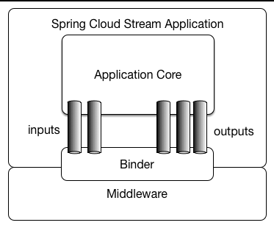
PPT模板下载：www.1ppt.com/moban/ 行业PPT模板：www.1ppt.com/hangye/
节日PPT模板：www.1ppt.com/jieri/ PPT素材下载：www.1ppt.com/sucai/
PPT背景图片：www.1ppt.com/beijing/ PPT图表下载：www.1ppt.com/tubiao/
优秀PPT下载：www.1ppt.com/xiazai/ PPT教程： www.1ppt.com/powerpoint/
Word教程： www.1ppt.com/word/ Excel教程：www.1ppt.com/excel/
资料下载：www.1ppt.com/ziliao/ PPT课件下载：www.1ppt.com/kejian/
范文下载：www.1ppt.com/fanwen/ 试卷下载：www.1ppt.com/shiti/
教案下载：www.1ppt.com/jiaoan/ PPT论坛：www.1ppt.cn

Slide 24
Spring Cloud Sleuth
https://github.com/spring-cloud/spring-cloud-sleuth
日志收集工具包，封装了Dapper和log-based追踪以及Zipkin和HTrace操作，为SpringCloud应用实现了一种分布式追踪解决方案
PPT模板下载：www.1ppt.com/moban/ 行业PPT模板：www.1ppt.com/hangye/
节日PPT模板：www.1ppt.com/jieri/ PPT素材下载：www.1ppt.com/sucai/
PPT背景图片：www.1ppt.com/beijing/ PPT图表下载：www.1ppt.com/tubiao/
优秀PPT下载：www.1ppt.com/xiazai/ PPT教程： www.1ppt.com/powerpoint/
Word教程： www.1ppt.com/word/ Excel教程：www.1ppt.com/excel/
资料下载：www.1ppt.com/ziliao/ PPT课件下载：www.1ppt.com/kejian/
范文下载：www.1ppt.com/fanwen/ 试卷下载：www.1ppt.com/shiti/
教案下载：www.1ppt.com/jiaoan/ PPT论坛：www.1ppt.cn

Slide 25
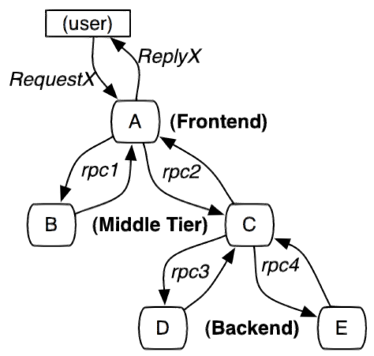
PPT模板下载：www.1ppt.com/moban/ 行业PPT模板：www.1ppt.com/hangye/
节日PPT模板：www.1ppt.com/jieri/ PPT素材下载：www.1ppt.com/sucai/
PPT背景图片：www.1ppt.com/beijing/ PPT图表下载：www.1ppt.com/tubiao/
优秀PPT下载：www.1ppt.com/xiazai/ PPT教程： www.1ppt.com/powerpoint/
Word教程： www.1ppt.com/word/ Excel教程：www.1ppt.com/excel/
资料下载：www.1ppt.com/ziliao/ PPT课件下载：www.1ppt.com/kejian/
范文下载：www.1ppt.com/fanwen/ 试卷下载：www.1ppt.com/shiti/
教案下载：www.1ppt.com/jiaoan/ PPT论坛：www.1ppt.cn

Slide 26
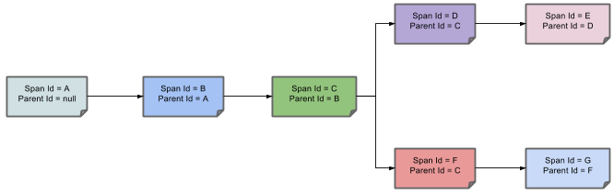
PPT模板下载：www.1ppt.com/moban/ 行业PPT模板：www.1ppt.com/hangye/
节日PPT模板：www.1ppt.com/jieri/ PPT素材下载：www.1ppt.com/sucai/
PPT背景图片：www.1ppt.com/beijing/ PPT图表下载：www.1ppt.com/tubiao/
优秀PPT下载：www.1ppt.com/xiazai/ PPT教程： www.1ppt.com/powerpoint/
Word教程： www.1ppt.com/word/ Excel教程：www.1ppt.com/excel/
资料下载：www.1ppt.com/ziliao/ PPT课件下载：www.1ppt.com/kejian/
范文下载：www.1ppt.com/fanwen/ 试卷下载：www.1ppt.com/shiti/
教案下载：www.1ppt.com/jiaoan/ PPT论坛：www.1ppt.cn

Slide 27
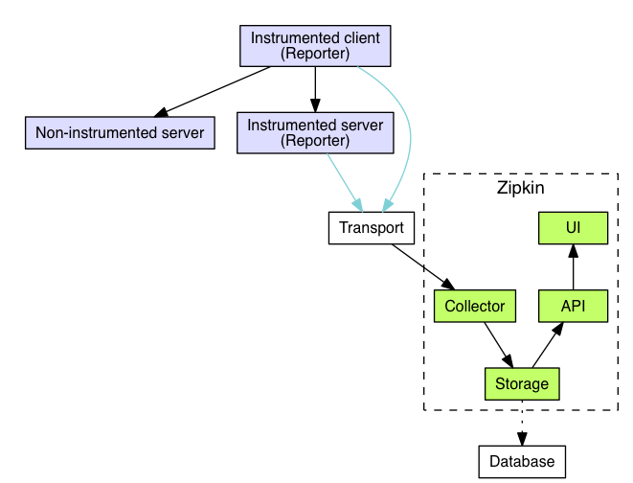
PPT模板下载：www.1ppt.com/moban/ 行业PPT模板：www.1ppt.com/hangye/
节日PPT模板：www.1ppt.com/jieri/ PPT素材下载：www.1ppt.com/sucai/
PPT背景图片：www.1ppt.com/beijing/ PPT图表下载：www.1ppt.com/tubiao/
优秀PPT下载：www.1ppt.com/xiazai/ PPT教程： www.1ppt.com/powerpoint/
Word教程： www.1ppt.com/word/ Excel教程：www.1ppt.com/excel/
资料下载：www.1ppt.com/ziliao/ PPT课件下载：www.1ppt.com/kejian/
范文下载：www.1ppt.com/fanwen/ 试卷下载：www.1ppt.com/shiti/
教案下载：www.1ppt.com/jiaoan/ PPT论坛：www.1ppt.cn

Slide 28
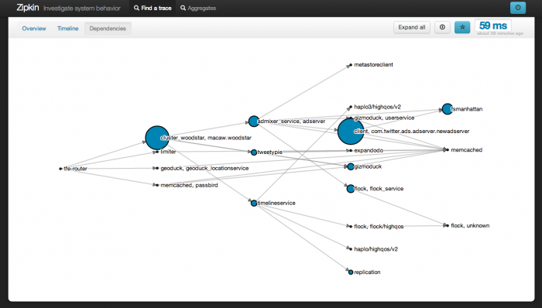
PPT模板下载：www.1ppt.com/moban/ 行业PPT模板：www.1ppt.com/hangye/
节日PPT模板：www.1ppt.com/jieri/ PPT素材下载：www.1ppt.com/sucai/
PPT背景图片：www.1ppt.com/beijing/ PPT图表下载：www.1ppt.com/tubiao/
优秀PPT下载：www.1ppt.com/xiazai/ PPT教程： www.1ppt.com/powerpoint/
Word教程： www.1ppt.com/word/ Excel教程：www.1ppt.com/excel/
资料下载：www.1ppt.com/ziliao/ PPT课件下载：www.1ppt.com/kejian/
范文下载：www.1ppt.com/fanwen/ 试卷下载：www.1ppt.com/shiti/
教案下载：www.1ppt.com/jiaoan/ PPT论坛：www.1ppt.cn

Slide 29
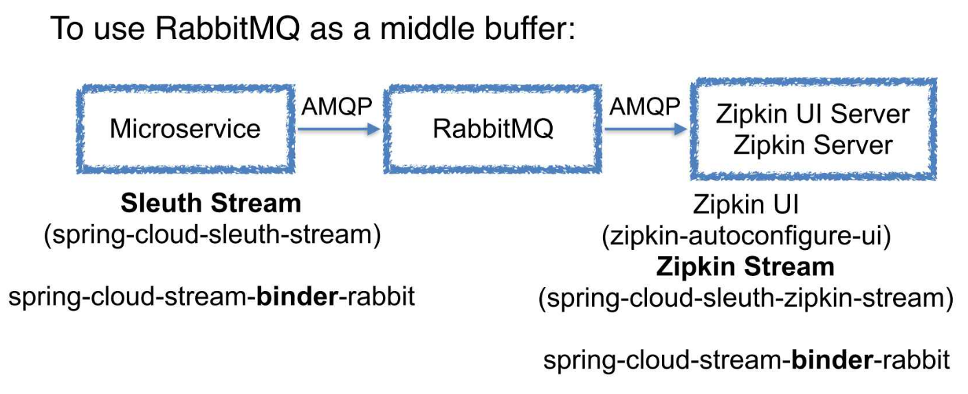
PPT模板下载：www.1ppt.com/moban/ 行业PPT模板：www.1ppt.com/hangye/
节日PPT模板：www.1ppt.com/jieri/ PPT素材下载：www.1ppt.com/sucai/
PPT背景图片：www.1ppt.com/beijing/ PPT图表下载：www.1ppt.com/tubiao/
优秀PPT下载：www.1ppt.com/xiazai/ PPT教程： www.1ppt.com/powerpoint/
Word教程： www.1ppt.com/word/ Excel教程：www.1ppt.com/excel/
资料下载：www.1ppt.com/ziliao/ PPT课件下载：www.1ppt.com/kejian/
范文下载：www.1ppt.com/fanwen/ 试卷下载：www.1ppt.com/shiti/
教案下载：www.1ppt.com/jiaoan/ PPT论坛：www.1ppt.cn

Slide 30

PPT模板下载：www.1ppt.com/moban/ 行业PPT模板：www.1ppt.com/hangye/
节日PPT模板：www.1ppt.com/jieri/ PPT素材下载：www.1ppt.com/sucai/
PPT背景图片：www.1ppt.com/beijing/ PPT图表下载：www.1ppt.com/tubiao/
优秀PPT下载：www.1ppt.com/xiazai/ PPT教程： www.1ppt.com/powerpoint/
Word教程： www.1ppt.com/word/ Excel教程：www.1ppt.com/excel/
资料下载：www.1ppt.com/ziliao/ PPT课件下载：www.1ppt.com/kejian/
范文下载：www.1ppt.com/fanwen/ 试卷下载：www.1ppt.com/shiti/
教案下载：www.1ppt.com/jiaoan/ PPT论坛：www.1ppt.cn

Slide 31

Code Example：
PPT模板下载：www.1ppt.com/moban/ 行业PPT模板：www.1ppt.com/hangye/
节日PPT模板：www.1ppt.com/jieri/ PPT素材下载：www.1ppt.com/sucai/
PPT背景图片：www.1ppt.com/beijing/ PPT图表下载：www.1ppt.com/tubiao/
优秀PPT下载：www.1ppt.com/xiazai/ PPT教程： www.1ppt.com/powerpoint/
Word教程： www.1ppt.com/word/ Excel教程：www.1ppt.com/excel/
资料下载：www.1ppt.com/ziliao/ PPT课件下载：www.1ppt.com/kejian/
范文下载：www.1ppt.com/fanwen/ 试卷下载：www.1ppt.com/shiti/
教案下载：www.1ppt.com/jiaoan/ PPT论坛：www.1ppt.cn

Slide 32

Microservices are not a silver bullet
The microservice architecture is not a silver bullet. It has several drawbacks. Moreover, when using this architecture there are numerous issues that you must address. The microservice architecture pattern language is a collection of patterns for applying the microservice architecture.
The pattern language enables you to decide whether microservices are a good fit for your application.
The pattern language enables you to use the microservice architecture successfully.
PPT模板下载：www.1ppt.com/moban/ 行业PPT模板：www.1ppt.com/hangye/
节日PPT模板：www.1ppt.com/jieri/ PPT素材下载：www.1ppt.com/sucai/
PPT背景图片：www.1ppt.com/beijing/ PPT图表下载：www.1ppt.com/tubiao/
优秀PPT下载：www.1ppt.com/xiazai/ PPT教程： www.1ppt.com/powerpoint/
Word教程： www.1ppt.com/word/ Excel教程：www.1ppt.com/excel/
资料下载：www.1ppt.com/ziliao/ PPT课件下载：www.1ppt.com/kejian/
范文下载：www.1ppt.com/fanwen/ 试卷下载：www.1ppt.com/shiti/
教案下载：www.1ppt.com/jiaoan/ PPT论坛：www.1ppt.cn

Slide 33
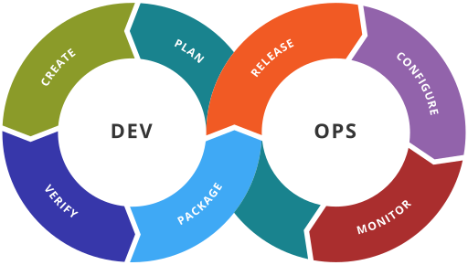
DevOps
PPT模板下载：www.1ppt.com/moban/ 行业PPT模板：www.1ppt.com/hangye/
节日PPT模板：www.1ppt.com/jieri/ PPT素材下载：www.1ppt.com/sucai/
PPT背景图片：www.1ppt.com/beijing/ PPT图表下载：www.1ppt.com/tubiao/
优秀PPT下载：www.1ppt.com/xiazai/ PPT教程： www.1ppt.com/powerpoint/
Word教程： www.1ppt.com/word/ Excel教程：www.1ppt.com/excel/
资料下载：www.1ppt.com/ziliao/ PPT课件下载：www.1ppt.com/kejian/
范文下载：www.1ppt.com/fanwen/ 试卷下载：www.1ppt.com/shiti/
教案下载：www.1ppt.com/jiaoan/ PPT论坛：www.1ppt.cn

Slide 34
DevOps toolchain
Code — code development and review, source code management tools, code merging
Build — continuous integration tools, build status
Test — continuous testing tools that provide feedback on business risks
Package — artifact repository, application pre-deployment staging
Release — change management, release approvals, release automation
Configure — infrastructure configuration and management, Infrastructure as Code tools
Monitor — applications performance monitoring, end–user experience
PPT模板下载：www.1ppt.com/moban/ 行业PPT模板：www.1ppt.com/hangye/
节日PPT模板：www.1ppt.com/jieri/ PPT素材下载：www.1ppt.com/sucai/
PPT背景图片：www.1ppt.com/beijing/ PPT图表下载：www.1ppt.com/tubiao/
优秀PPT下载：www.1ppt.com/xiazai/ PPT教程： www.1ppt.com/powerpoint/
Word教程： www.1ppt.com/word/ Excel教程：www.1ppt.com/excel/
资料下载：www.1ppt.com/ziliao/ PPT课件下载：www.1ppt.com/kejian/
范文下载：www.1ppt.com/fanwen/ 试卷下载：www.1ppt.com/shiti/
教案下载：www.1ppt.com/jiaoan/ PPT论坛：www.1ppt.cn

Slide 35



DevOps Tools
PPT模板下载：www.1ppt.com/moban/ 行业PPT模板：www.1ppt.com/hangye/
节日PPT模板：www.1ppt.com/jieri/ PPT素材下载：www.1ppt.com/sucai/
PPT背景图片：www.1ppt.com/beijing/ PPT图表下载：www.1ppt.com/tubiao/
优秀PPT下载：www.1ppt.com/xiazai/ PPT教程： www.1ppt.com/powerpoint/
Word教程： www.1ppt.com/word/ Excel教程：www.1ppt.com/excel/
资料下载：www.1ppt.com/ziliao/ PPT课件下载：www.1ppt.com/kejian/
范文下载：www.1ppt.com/fanwen/ 试卷下载：www.1ppt.com/shiti/
教案下载：www.1ppt.com/jiaoan/ PPT论坛：www.1ppt.cn

Slide 36

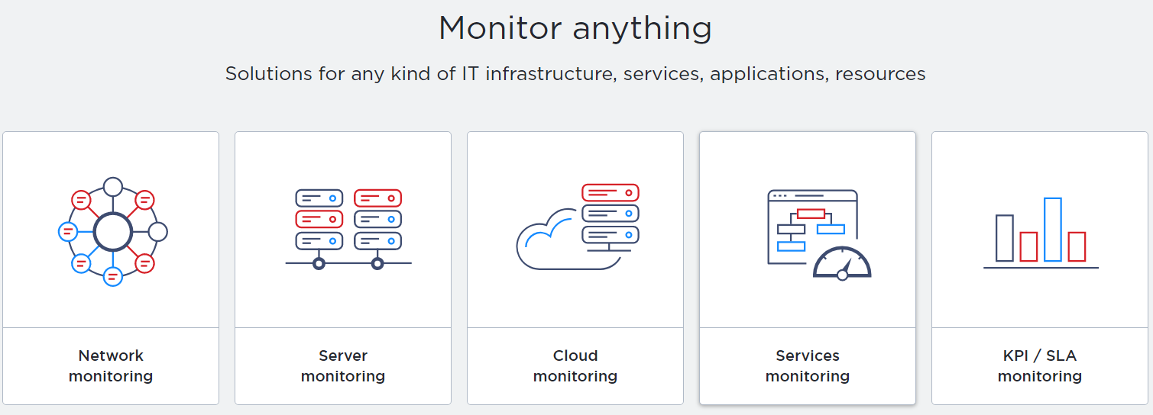
Monitor Tools
PPT模板下载：www.1ppt.com/moban/ 行业PPT模板：www.1ppt.com/hangye/
节日PPT模板：www.1ppt.com/jieri/ PPT素材下载：www.1ppt.com/sucai/
PPT背景图片：www.1ppt.com/beijing/ PPT图表下载：www.1ppt.com/tubiao/
优秀PPT下载：www.1ppt.com/xiazai/ PPT教程： www.1ppt.com/powerpoint/
Word教程： www.1ppt.com/word/ Excel教程：www.1ppt.com/excel/
资料下载：www.1ppt.com/ziliao/ PPT课件下载：www.1ppt.com/kejian/
范文下载：www.1ppt.com/fanwen/ 试卷下载：www.1ppt.com/shiti/
教案下载：www.1ppt.com/jiaoan/ PPT论坛：www.1ppt.cn

Slide 37

推荐学习网址 - Spring Cloud
http://projects.spring.io/spring-cloud/
https://github.com/spring-cloud
PPT模板下载：www.1ppt.com/moban/ 行业PPT模板：www.1ppt.com/hangye/
节日PPT模板：www.1ppt.com/jieri/ PPT素材下载：www.1ppt.com/sucai/
PPT背景图片：www.1ppt.com/beijing/ PPT图表下载：www.1ppt.com/tubiao/
优秀PPT下载：www.1ppt.com/xiazai/ PPT教程： www.1ppt.com/powerpoint/
Word教程： www.1ppt.com/word/ Excel教程：www.1ppt.com/excel/
资料下载：www.1ppt.com/ziliao/ PPT课件下载：www.1ppt.com/kejian/
范文下载：www.1ppt.com/fanwen/ 试卷下载：www.1ppt.com/shiti/
教案下载：www.1ppt.com/jiaoan/ PPT论坛：www.1ppt.cn

Slide 38

PPT模板下载：www.1ppt.com/moban/ 行业PPT模板：www.1ppt.com/hangye/
节日PPT模板：www.1ppt.com/jieri/ PPT素材下载：www.1ppt.com/sucai/
PPT背景图片：www.1ppt.com/beijing/ PPT图表下载：www.1ppt.com/tubiao/
优秀PPT下载：www.1ppt.com/xiazai/ PPT教程： www.1ppt.com/powerpoint/
Word教程： www.1ppt.com/word/ Excel教程：www.1ppt.com/excel/
资料下载：www.1ppt.com/ziliao/ PPT课件下载：www.1ppt.com/kejian/
范文下载：www.1ppt.com/fanwen/ 试卷下载：www.1ppt.com/shiti/
教案下载：www.1ppt.com/jiaoan/ PPT论坛：www.1ppt.cn

Slide 39

PPT模板下载：www.1ppt.com/moban/ 行业PPT模板：www.1ppt.com/hangye/
节日PPT模板：www.1ppt.com/jieri/ PPT素材下载：www.1ppt.com/sucai/
PPT背景图片：www.1ppt.com/beijing/ PPT图表下载：www.1ppt.com/tubiao/
优秀PPT下载：www.1ppt.com/xiazai/ PPT教程： www.1ppt.com/powerpoint/
Word教程： www.1ppt.com/word/ Excel教程：www.1ppt.com/excel/
资料下载：www.1ppt.com/ziliao/ PPT课件下载：www.1ppt.com/kejian/
范文下载：www.1ppt.com/fanwen/ 试卷下载：www.1ppt.com/shiti/
教案下载：www.1ppt.com/jiaoan/ PPT论坛：www.1ppt.cn

